Slide 1
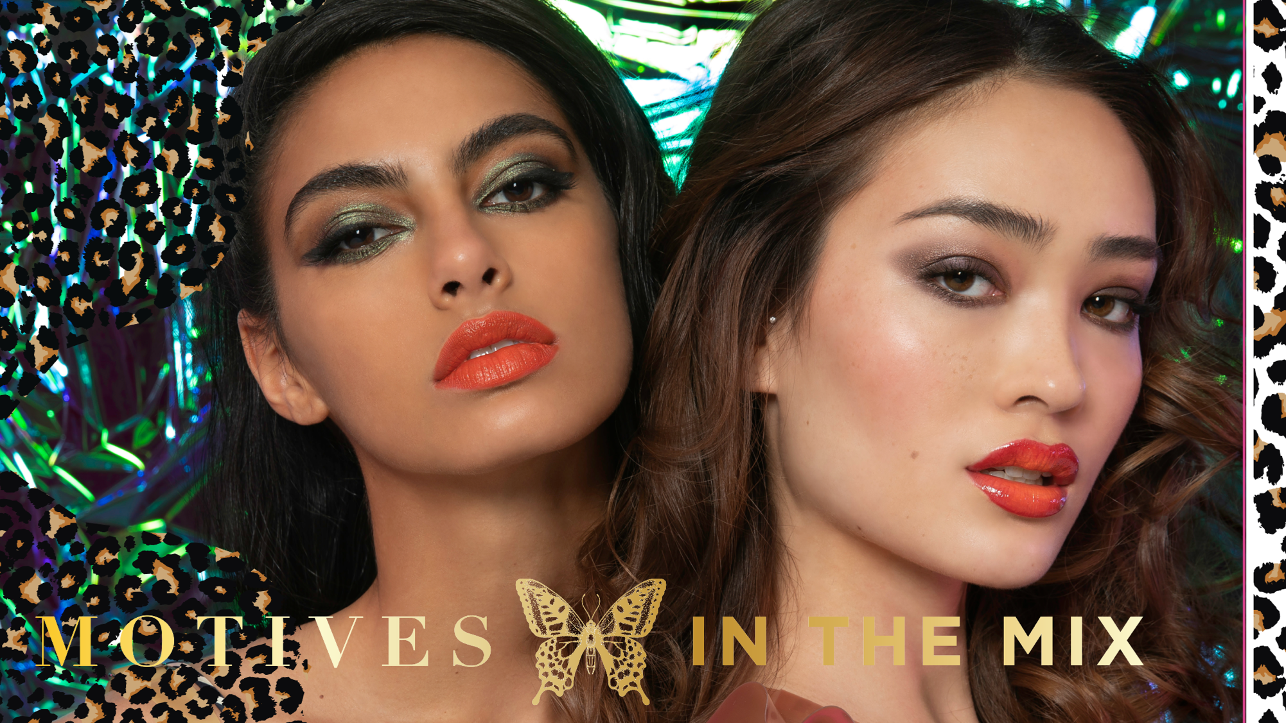

Slide 2
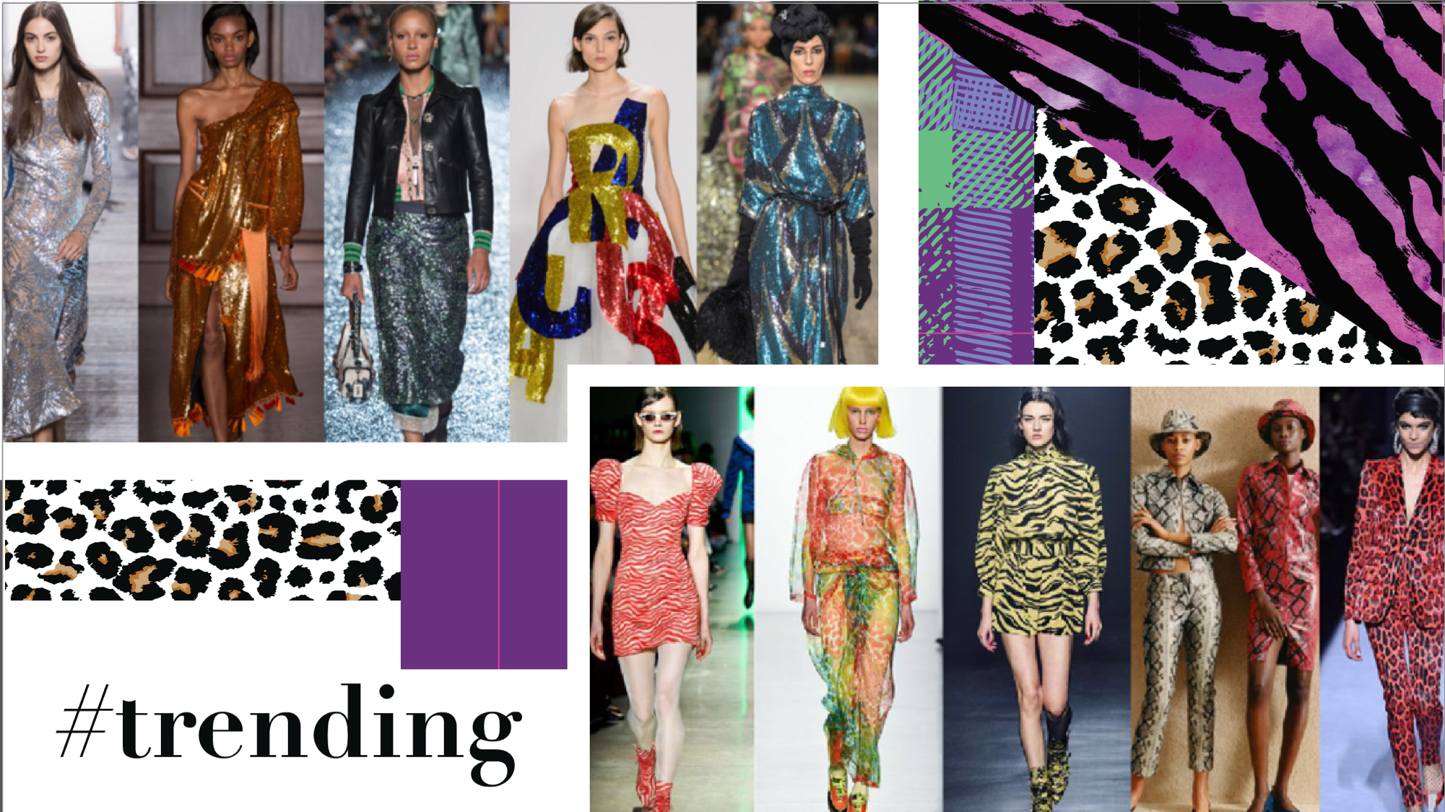

Slide 3
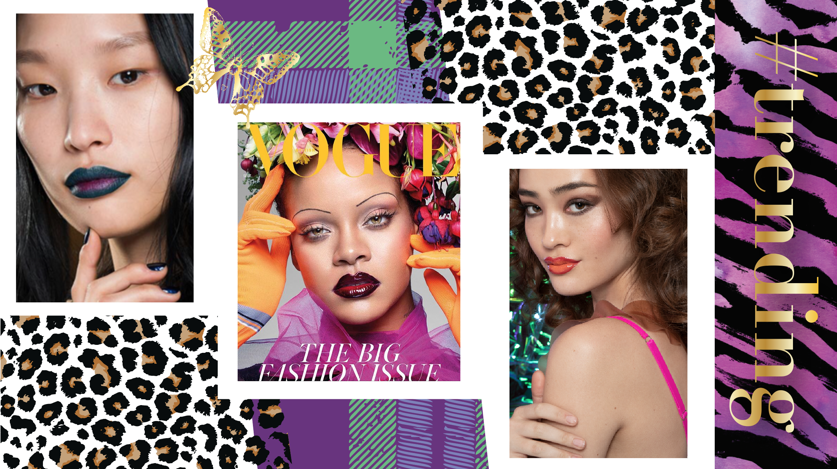

Slide 4

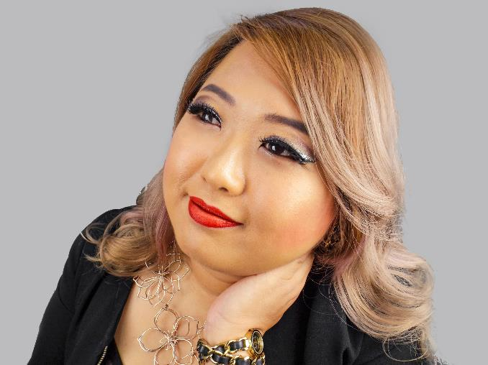
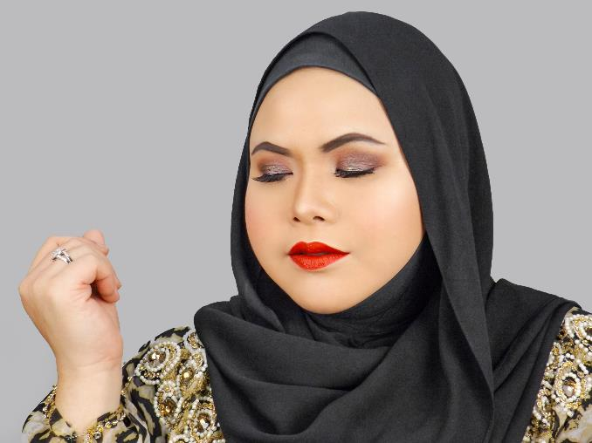
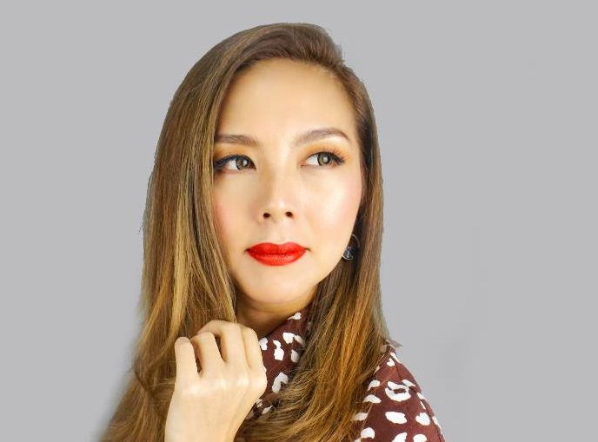
Shop For the Model looks
Please visit our Facebook page @MarketSingapore

Slide 5
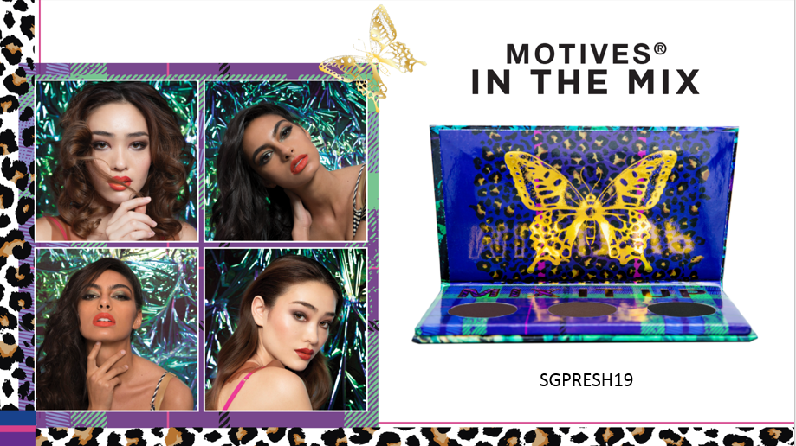

Slide 6
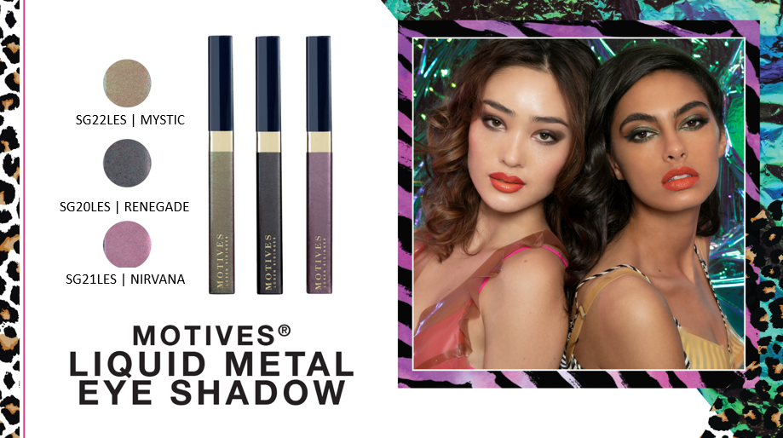

Slide 7
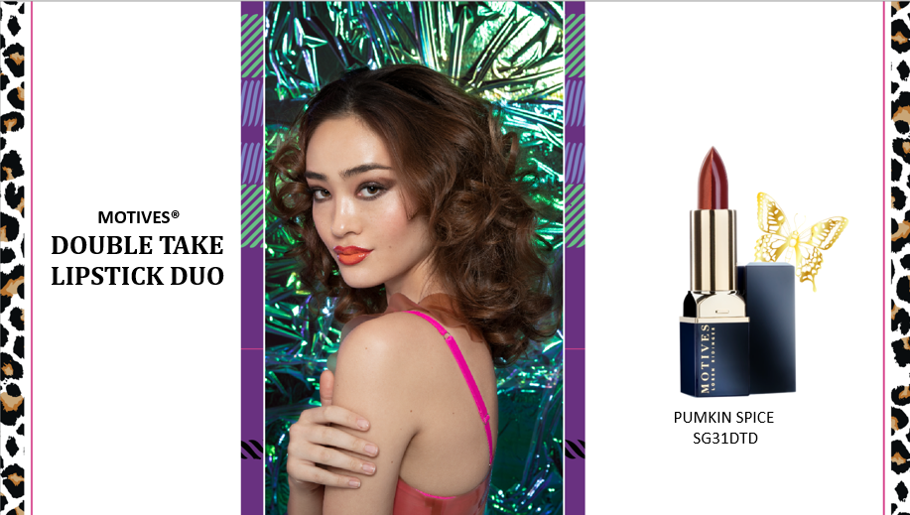
PUMPKIN SPICE

Slide 8
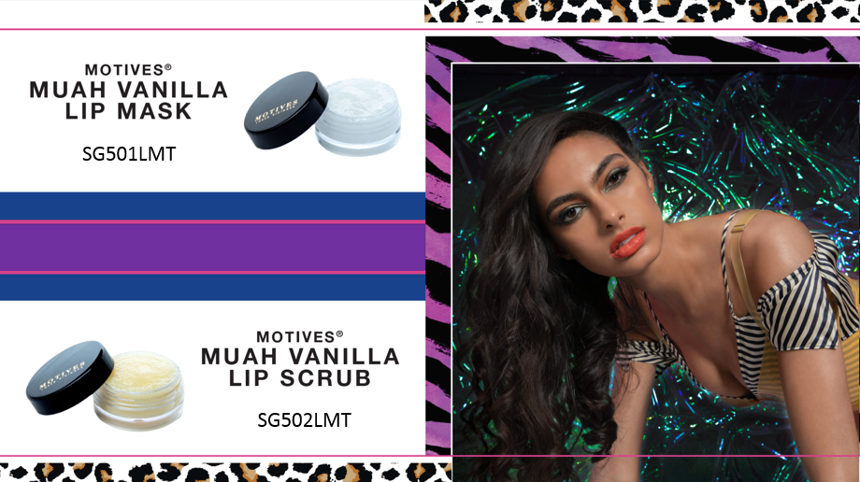

Slide 9
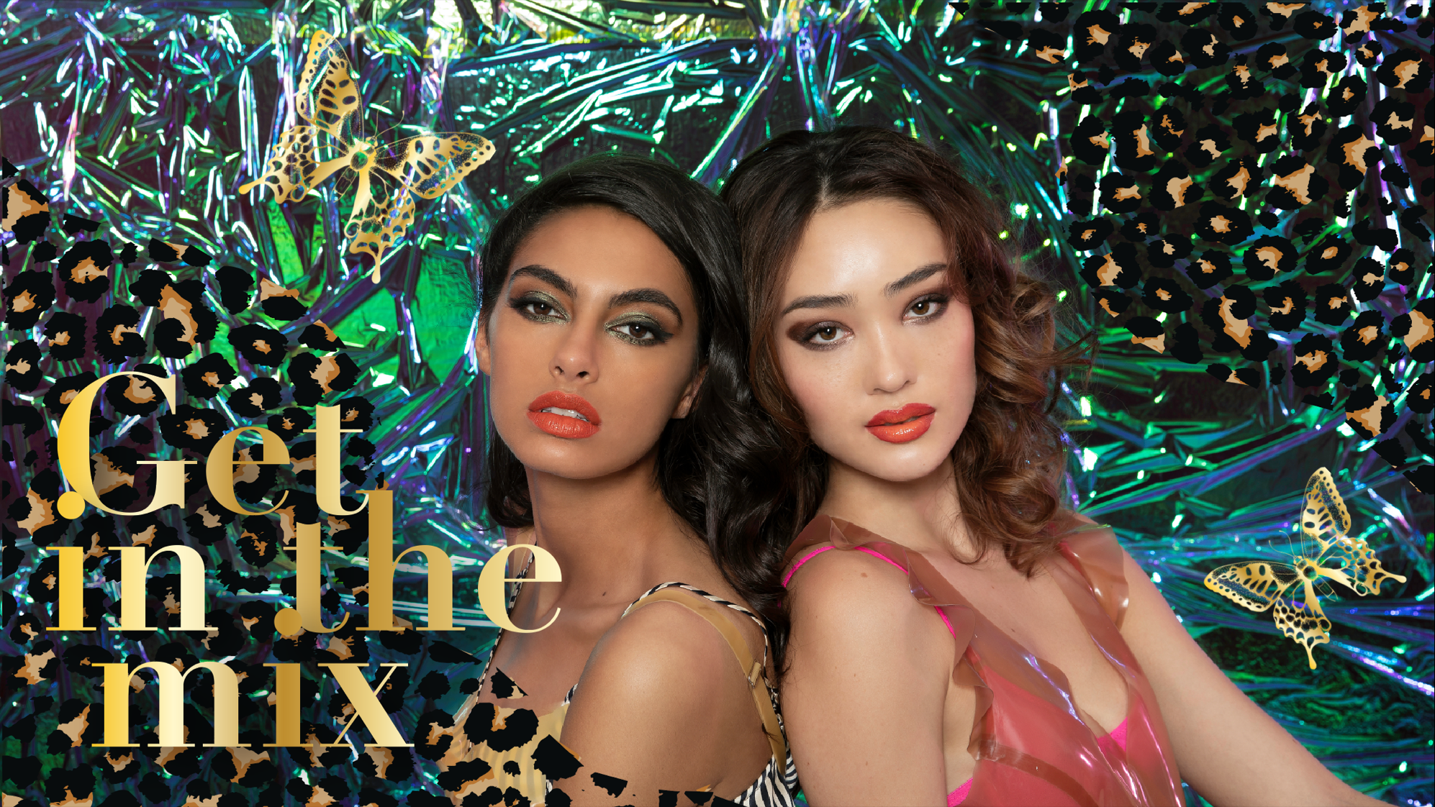

Slide 10

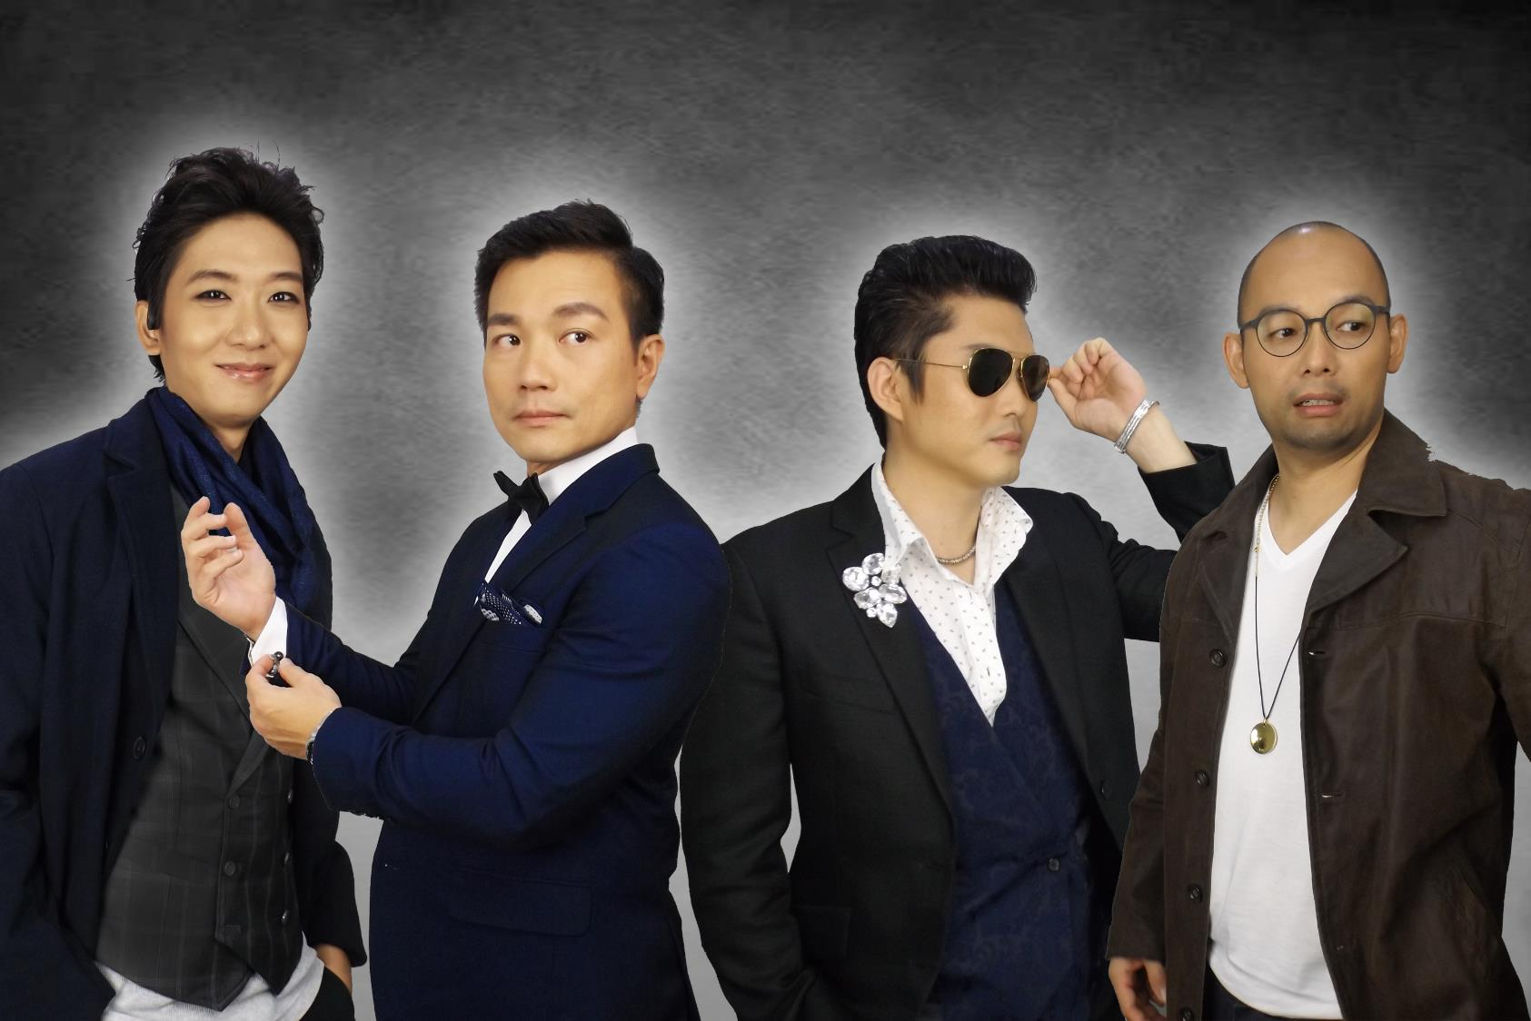


Placeholder for all 4 male model pics
Makeover by
Fashion by

Slide 12

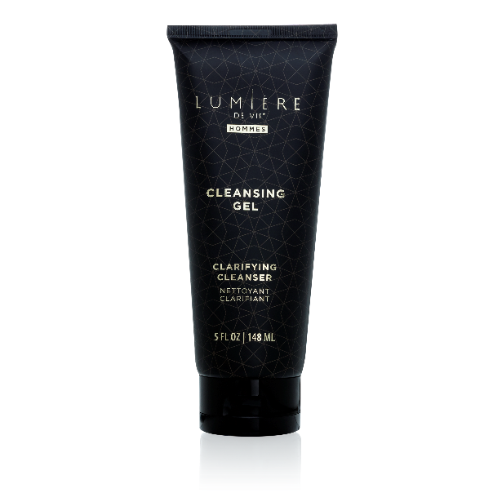
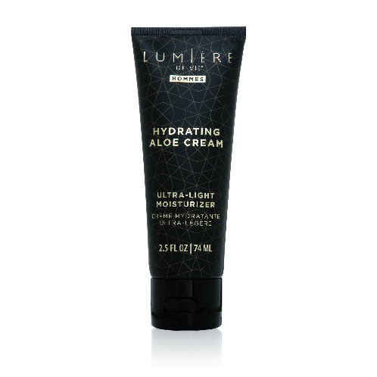

Slide 13
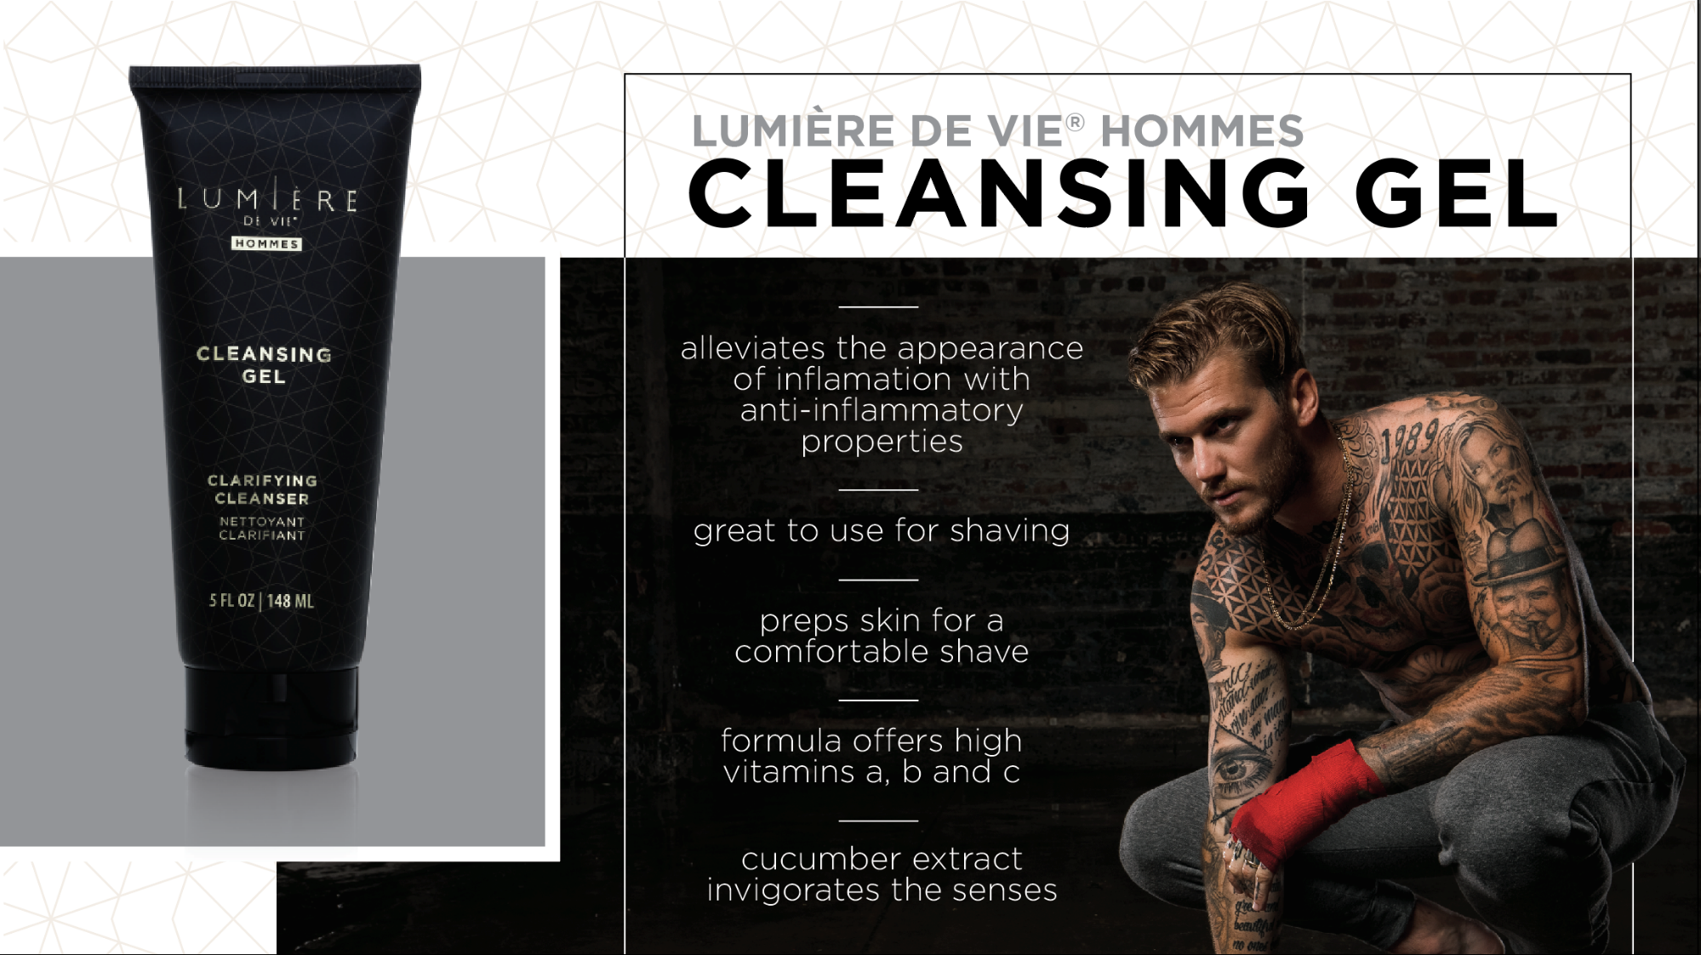
SG16101

Slide 14
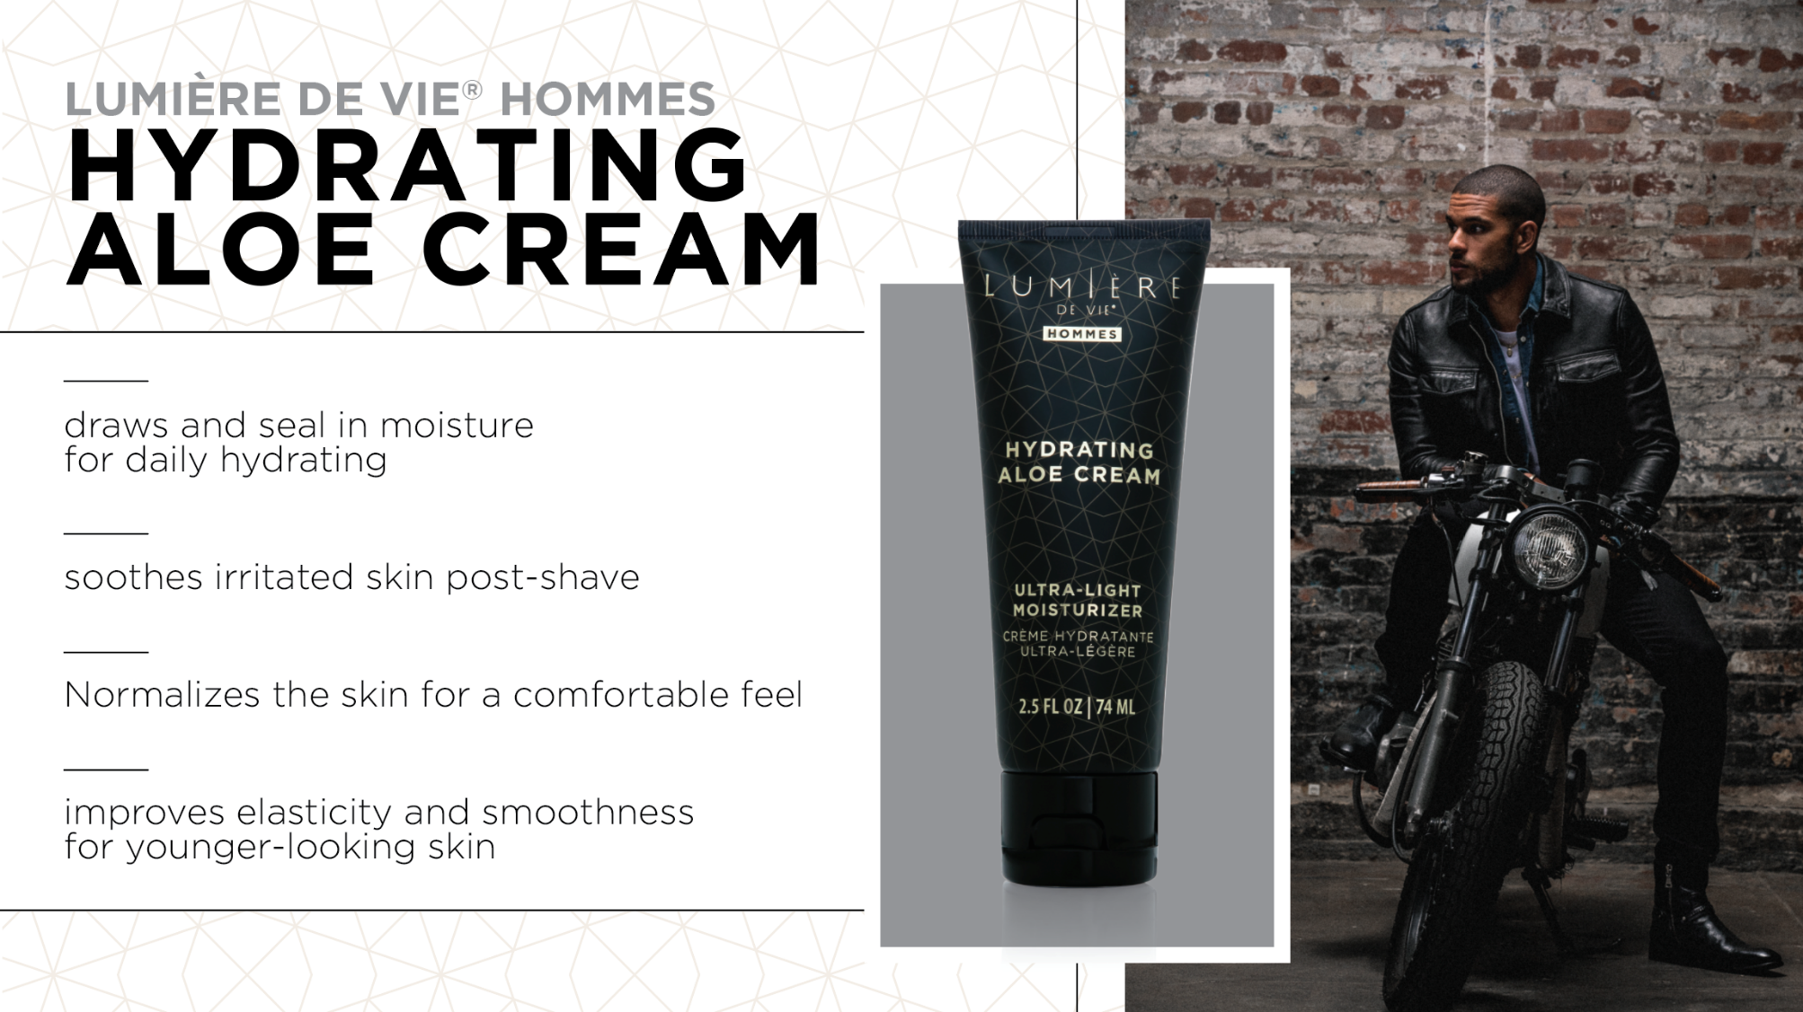
Draws and seal in moisture for daily hydrating
Soothes irritated skin post-shave
Normalises the skin for a comfortable feel
Improves elasticity and smoothness for younger-looking skin
SG16100

Slide 15


Slide 16
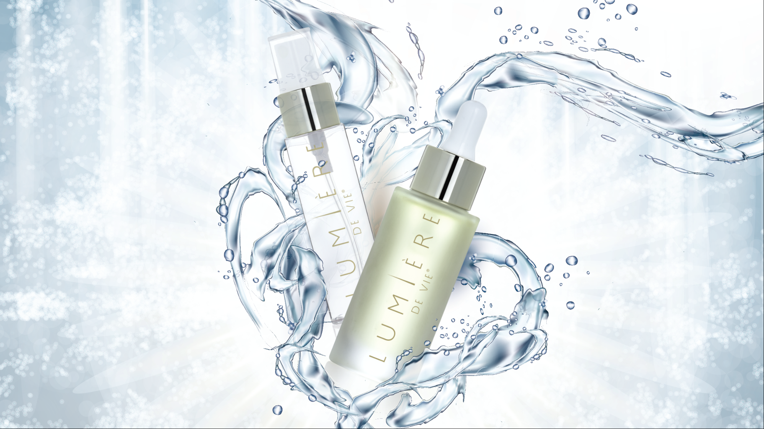
PRODCUTS
NEW

Slide 17
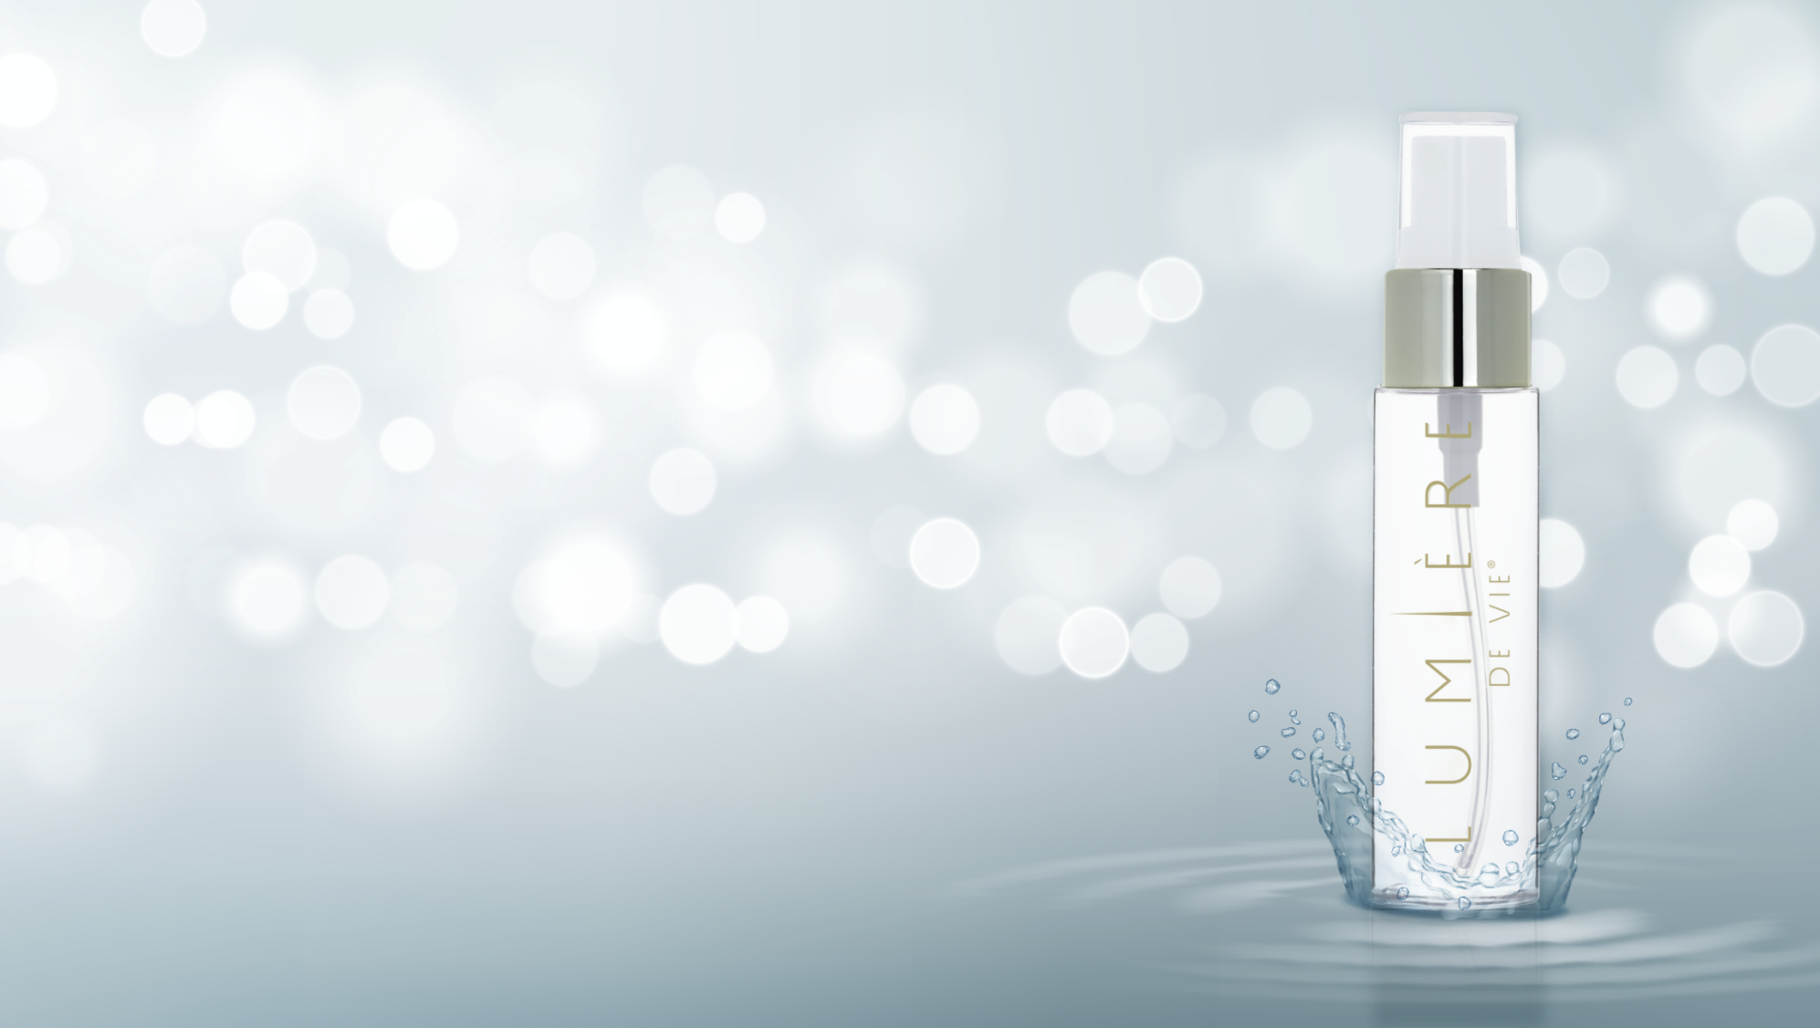
Lumière de Vie®
ROSÉ
REFRESHER
BENEFITS
Moisturises and soothes the skin with aloe
Botanimoist infuses the skin with hydration
Brightens the skin for a more radiant complexion
Provides a supple look and feel for refined skin
Perfect pick-me-up to refresh your look throughout the day
SG12224
Coming Soon

Slide 18
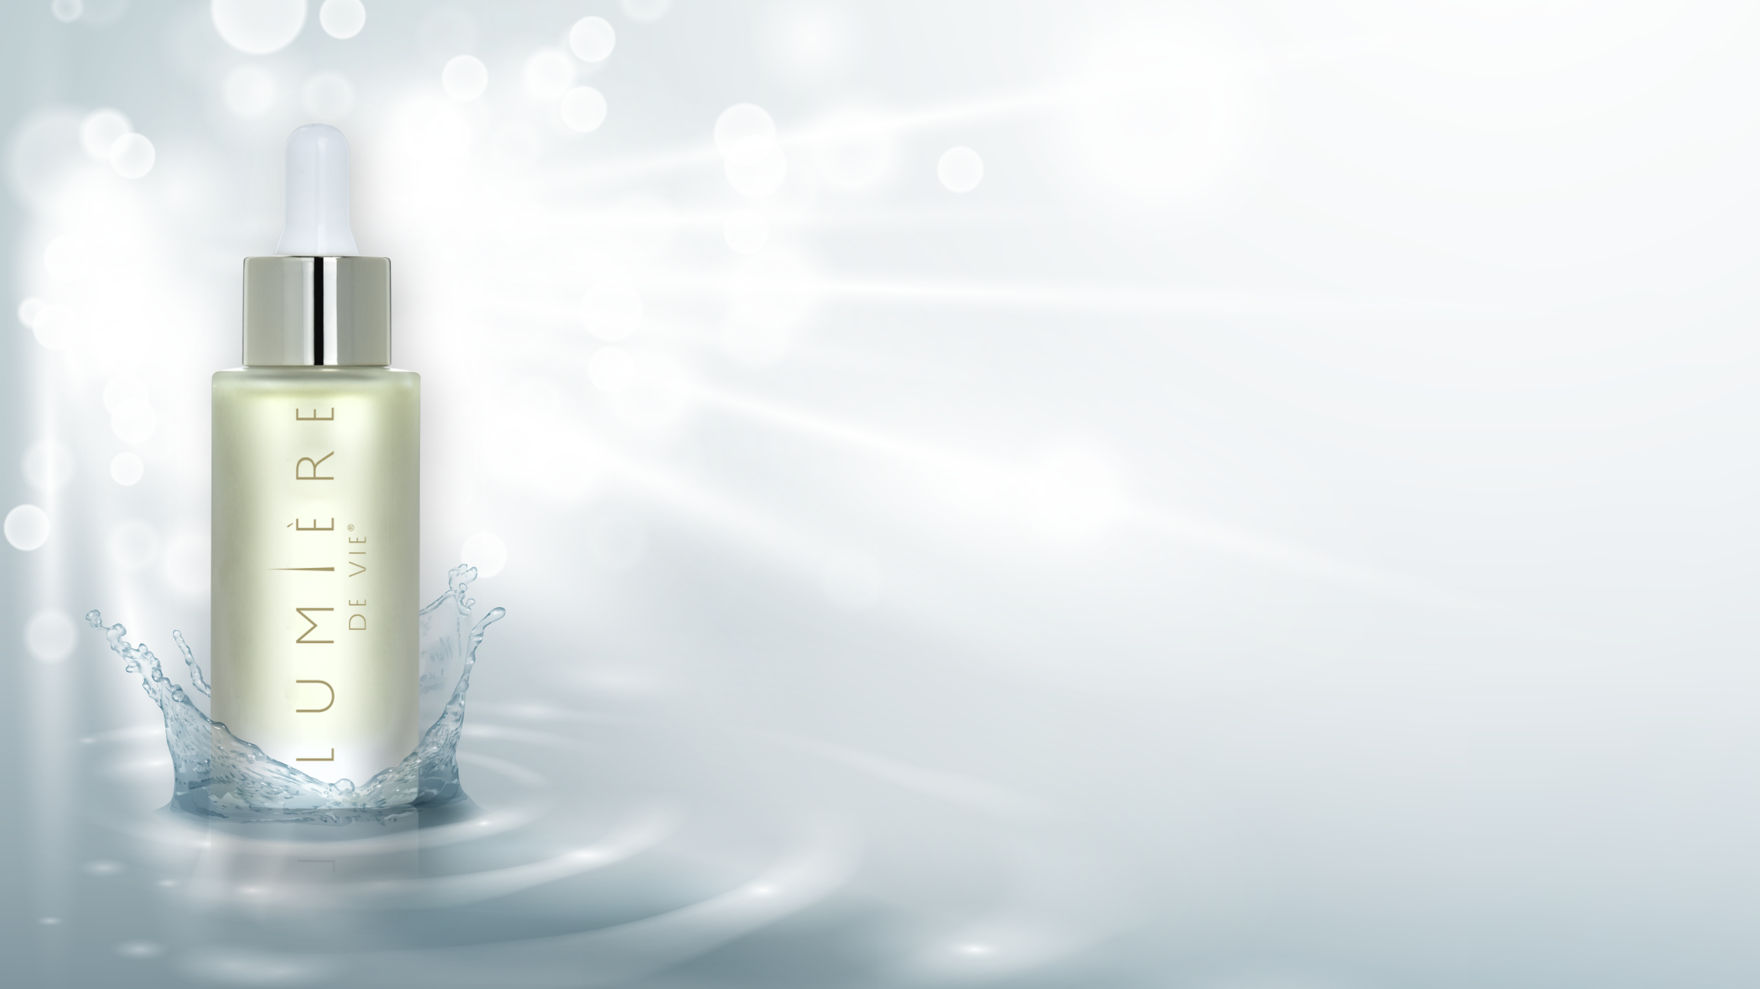
Lumière de Vie®
RENEWAL
ELIXIR
BENEFITS
Moisturises to reduce the appearance of rough skin
Improves skin elasticity
Reduces the appearance of wrinkles and dark spots
Helps skin feel firmer for younger-looking skin
Add to your favorite moisturiser for ultimate hydration
SG12222
Coming Soon

Slide 19
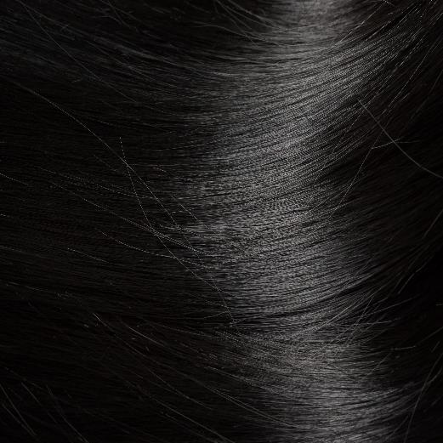

Slide 20
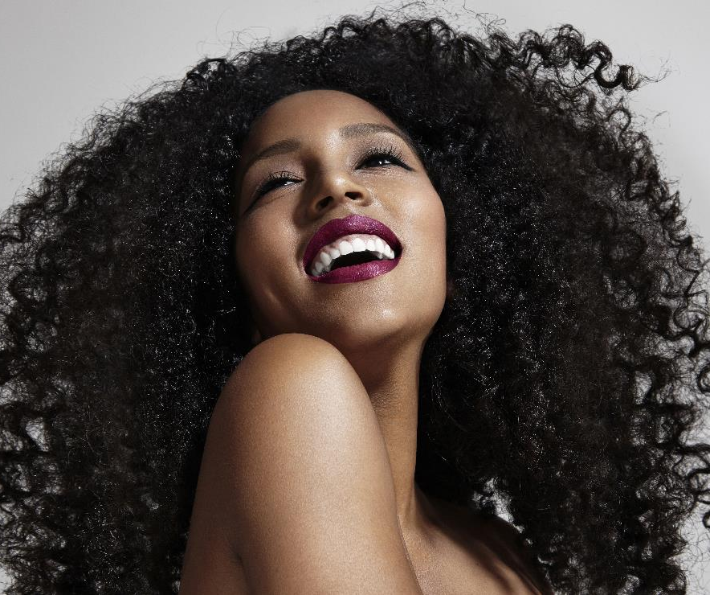
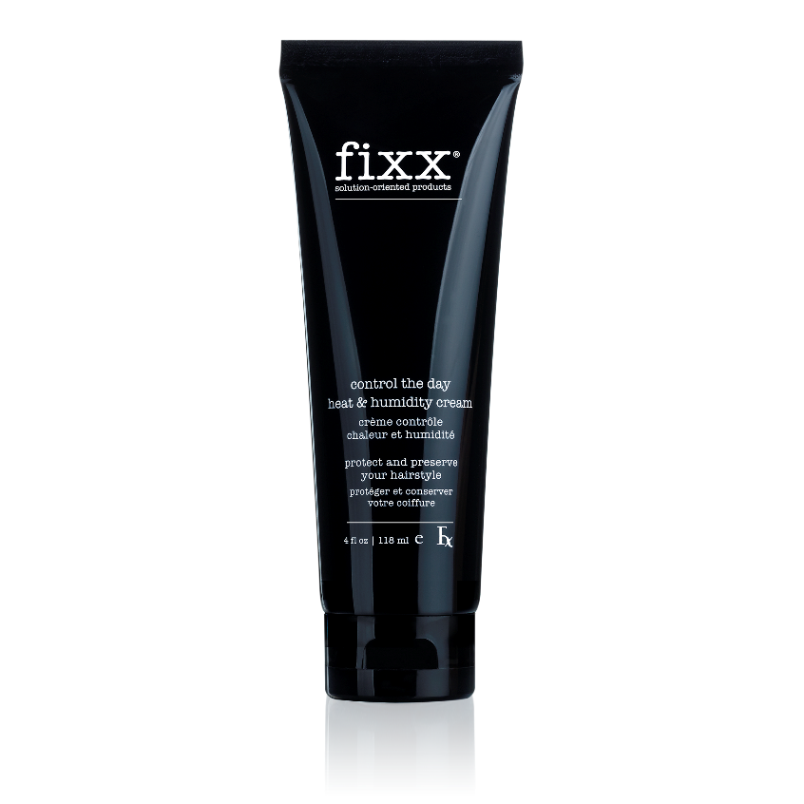
Ama-oil formulated cream reduces the effects of humidity
Smooths hair to combat frizz
in humid environments
Apply to wet hair for weightless protection that maintains your style
Ideal for all hair types
SG12536
CONTROL THE DAY HEAT
AND HUMIDITY CREAM

Slide 21
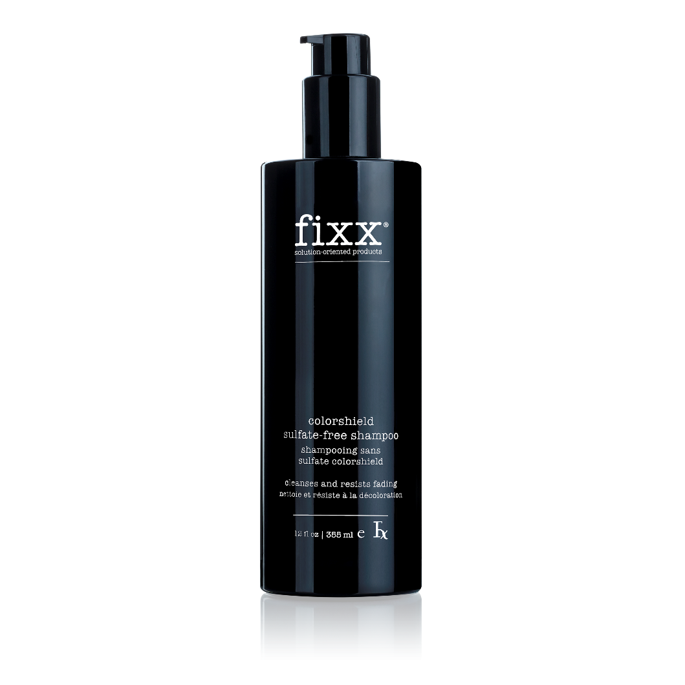
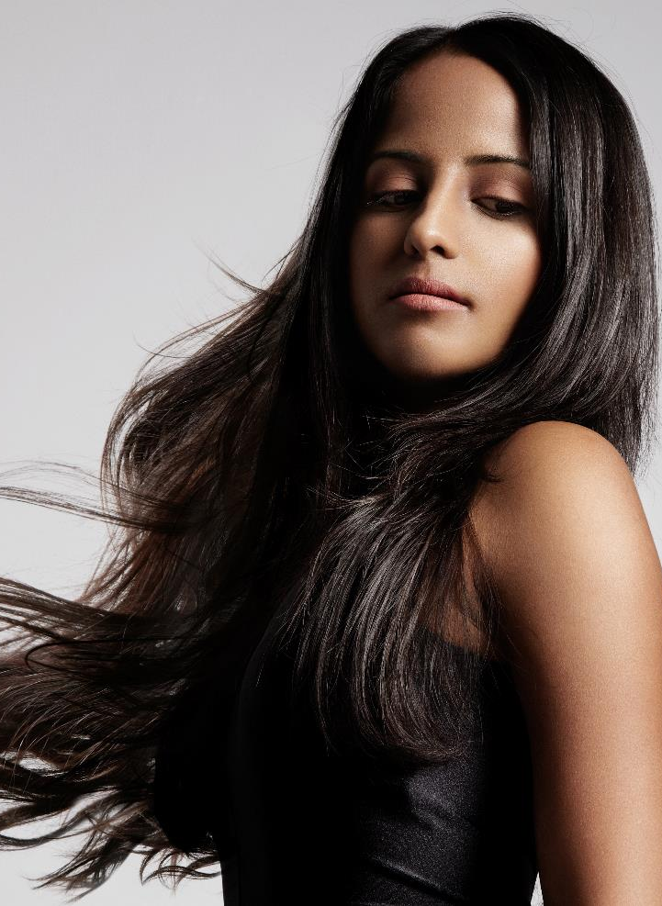

COLOR SHEILD
SULFATE-FREE
SHAMPOO
Sulfate-free formula cleanses hair without stripping colour
Resists fading to extend the life of colour treatments
Helps maintain hair vibrancy for brilliant colour and shine
Conditions for smoother-looking hair
SG12532
Ideal for colour-treated hair

Slide 22

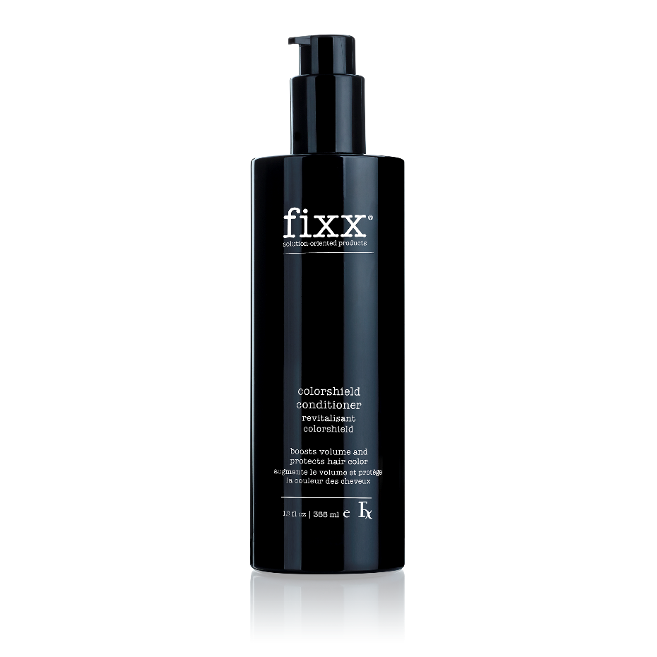
COLORSHIELD
CONDITIONER
Protects hair colour from fading
Maintains luminosity and vibrancy
for shiny, healthy-looking hair
Conditions for smoother, softer-feeling hair
Rice protein boosts hair volume
Ideal for colour-treated hair
SG12534

Slide 23
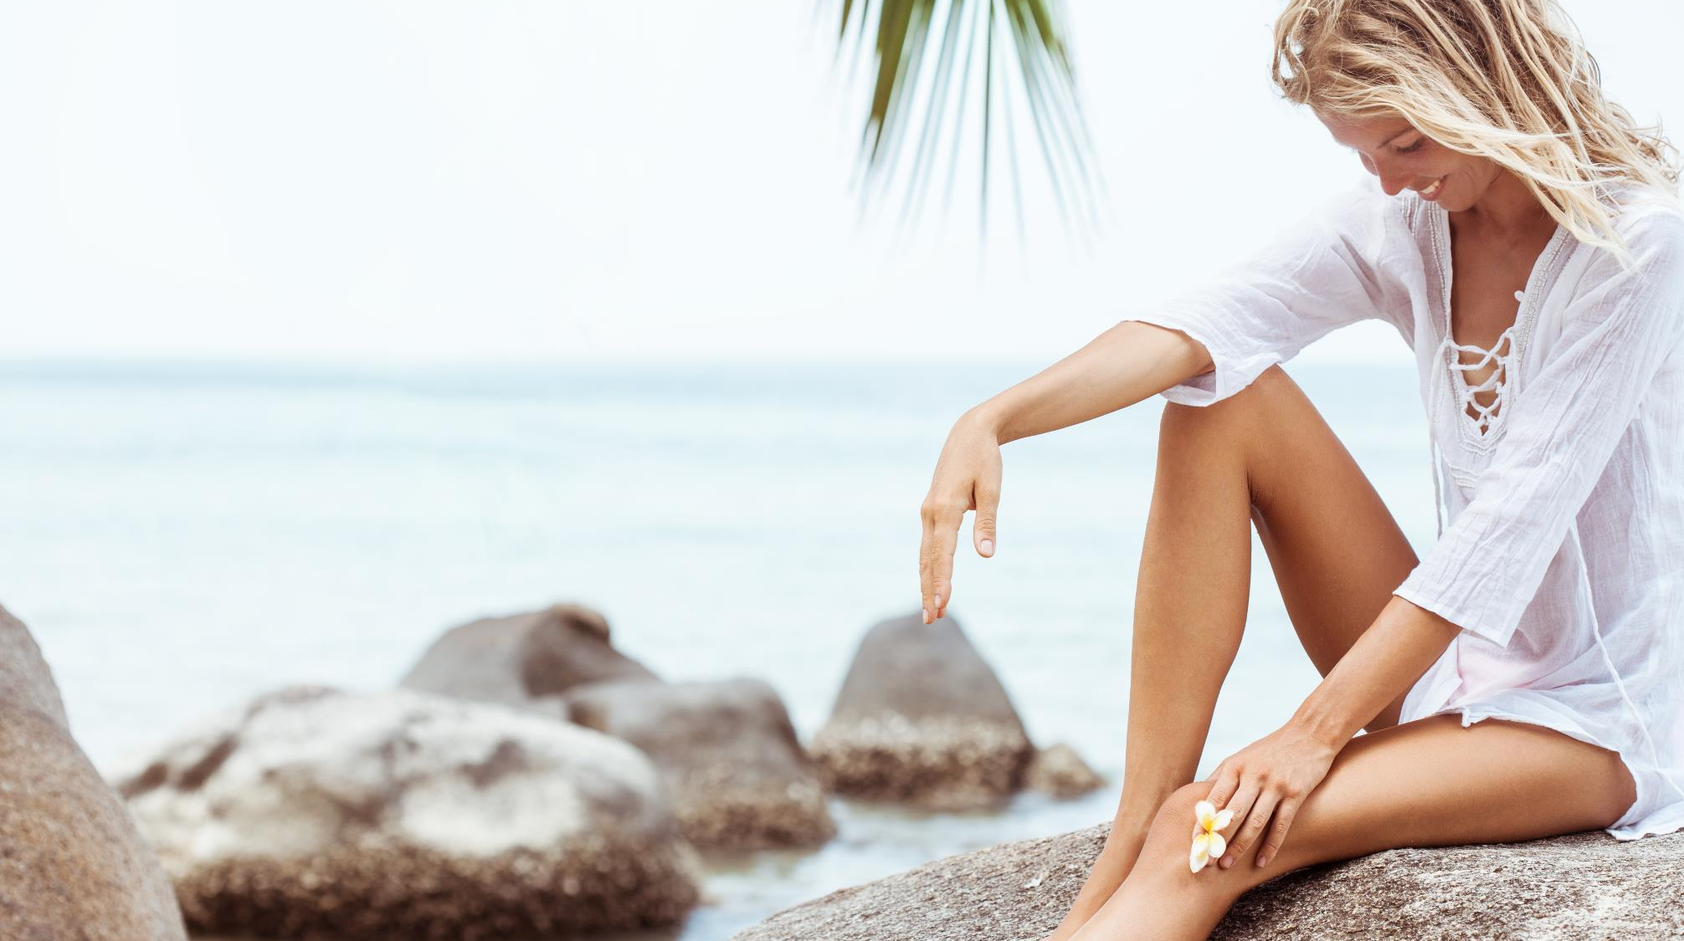


Slide 24
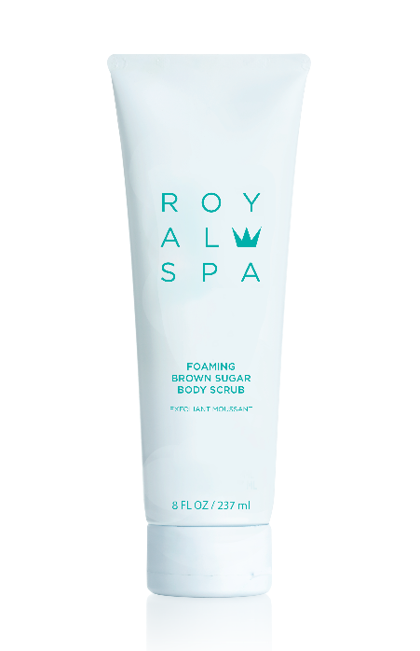
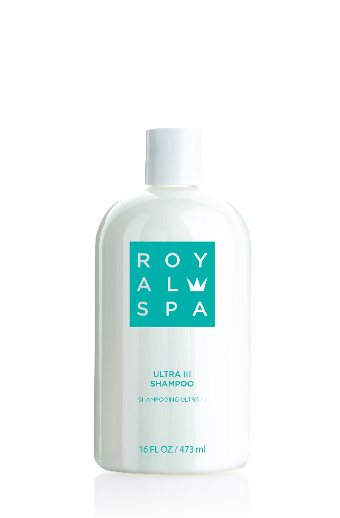
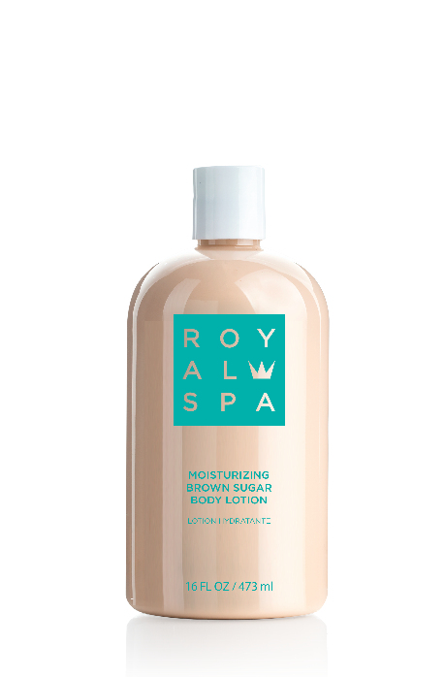
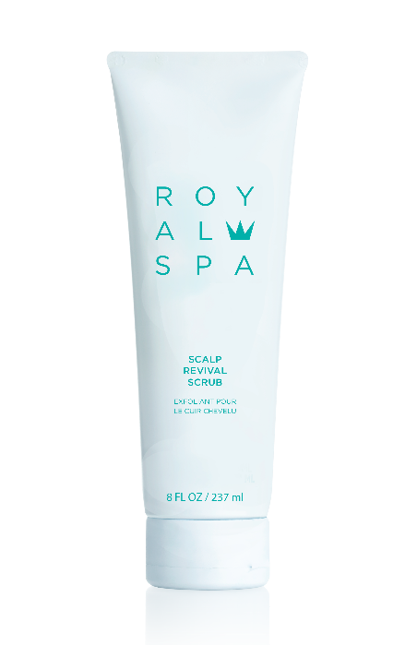
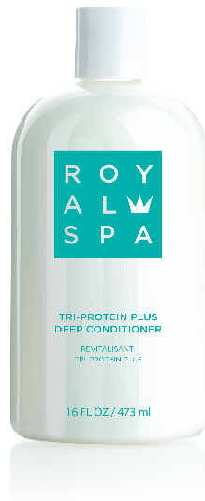
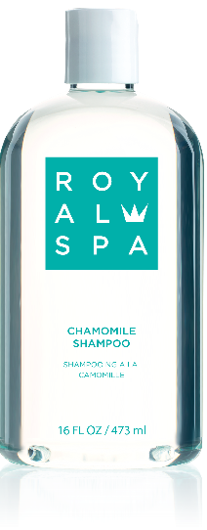
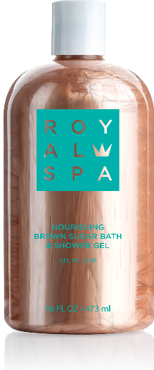
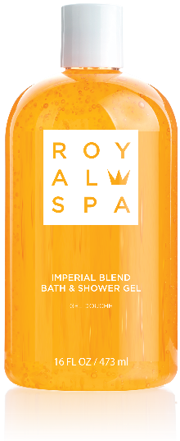
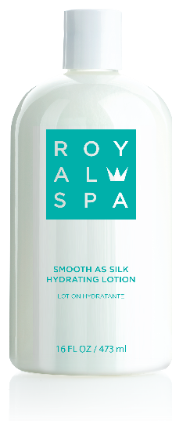
YOUR FAVOURITE LUXURY SPA BRAND NOW HAS A NEW LOOK.

Slide 25
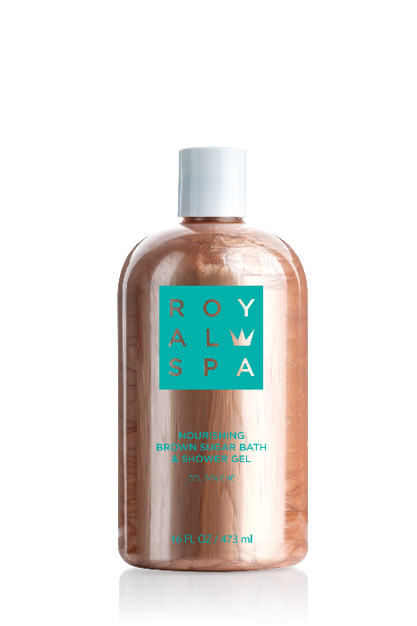
NEW
PRODUCTS

Slide 26
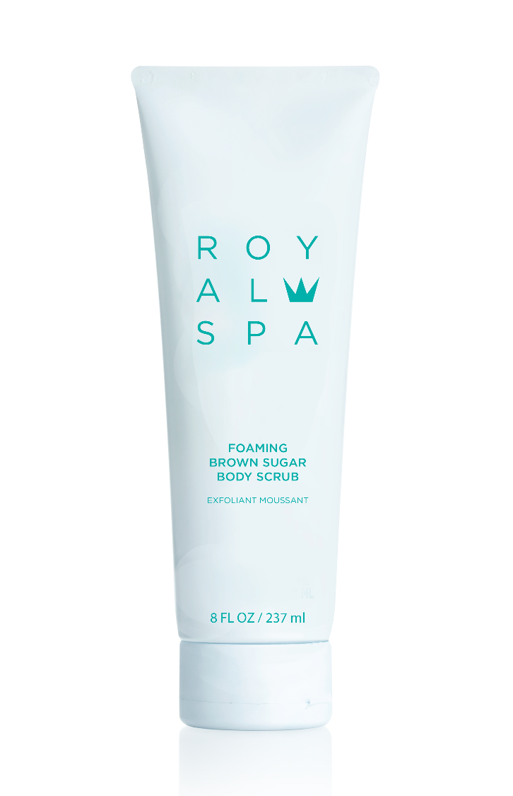
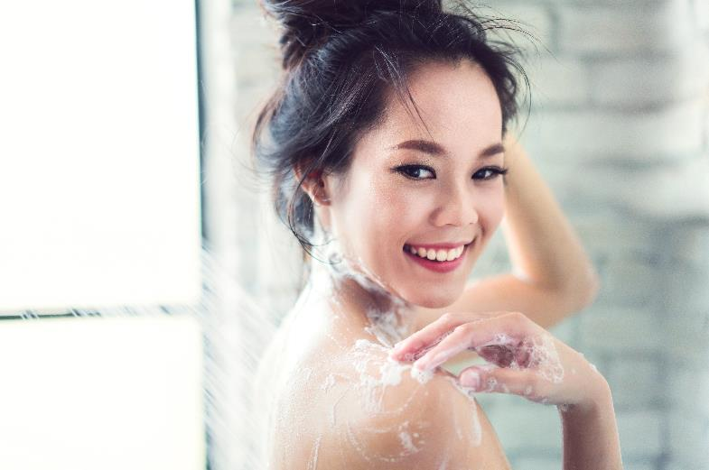
FOAMING BROWN
SUGAR SCRUB
Brown sugar crystals gently polish away dull, rough skin
Walnut shell powder exfoliates
to soften skin
Foaming action cleanses skin
of dirt and impurities
Leaves skin looking smooth
and refreshed
Pleasant, subtle scent of
brown sugar
SG12016

Slide 27
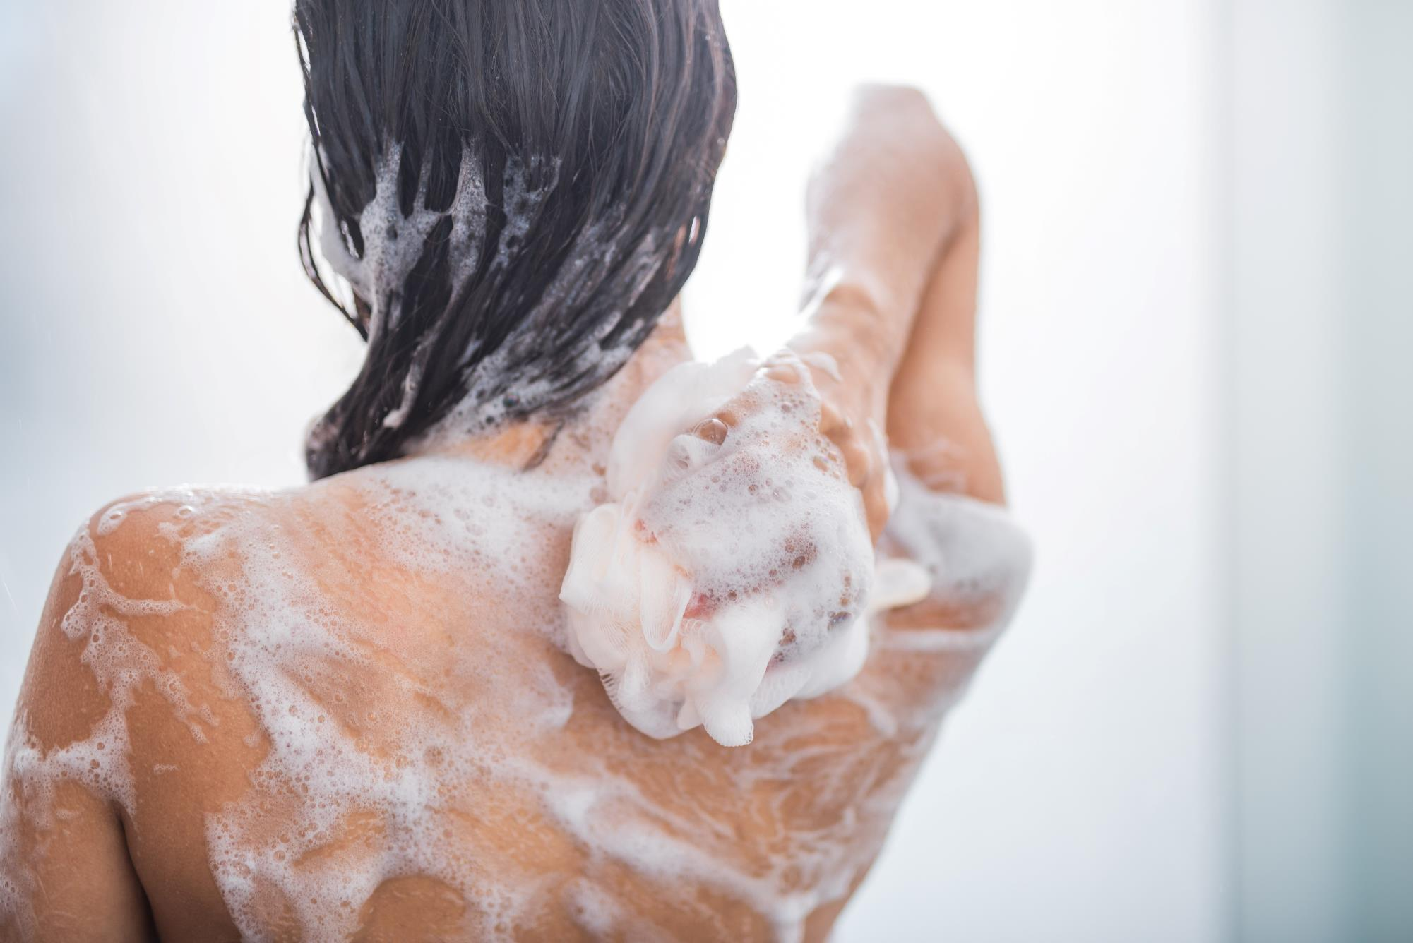

NOURISHING BROWN SUGAR BATH AND SHOWER GEL
NOURISHING LATHER
CLEANSES THE BODY
DOES NOT DRY OUT
SKIN LIKE BAR SOAP
LEAVES SKIN DELICATELY
SCENTED WITH BROWN SUGAR
SG12026

Slide 28
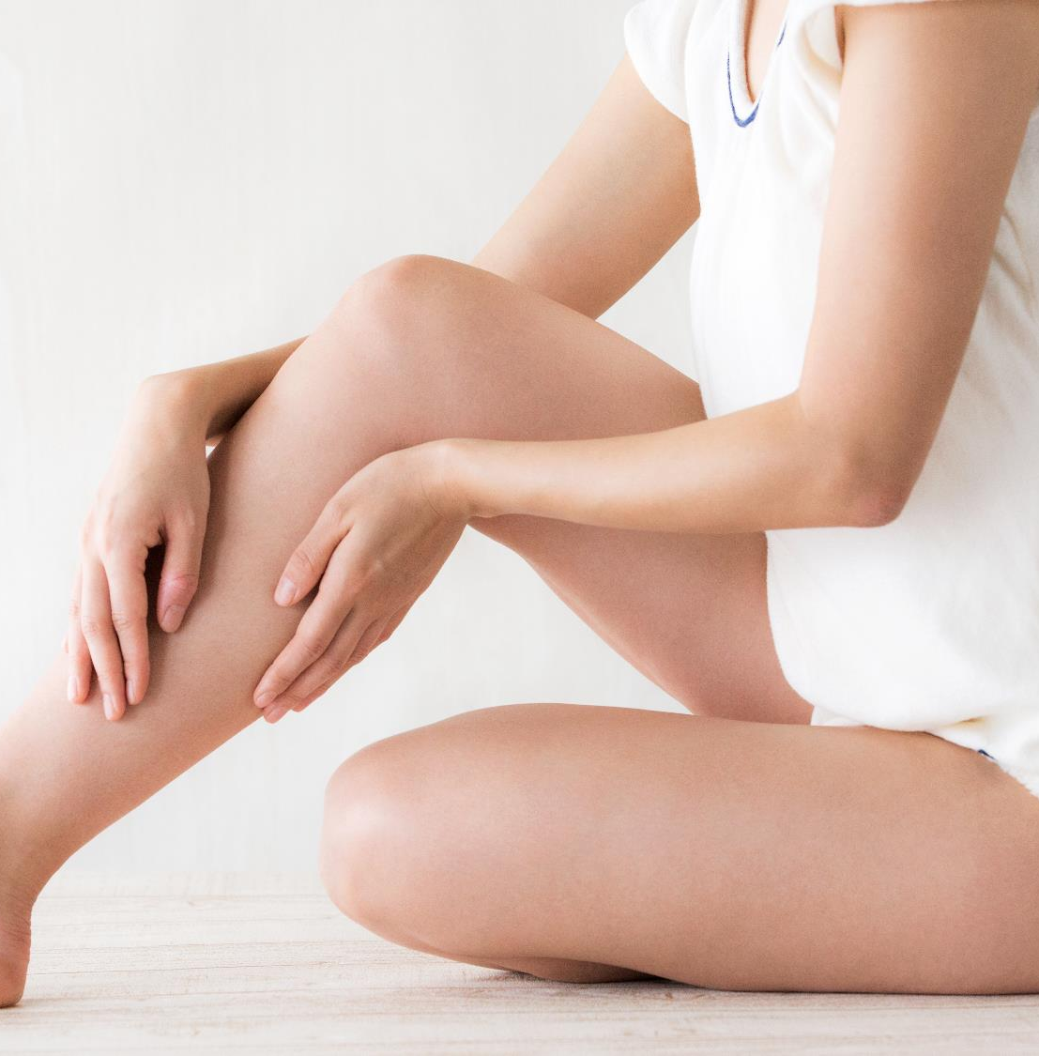

MOISTURIZING
BROWN SUGAR
BODY LOTION
MOISTURISES THE BODY FOR SMOOTHER-FEELING SKIN
CONDITIONS TO RELIEVE
DRY SKIN
LEAVES SKIN DELICATELY SCENTED WITH BROWN SUGAR
SG12028

Slide 29
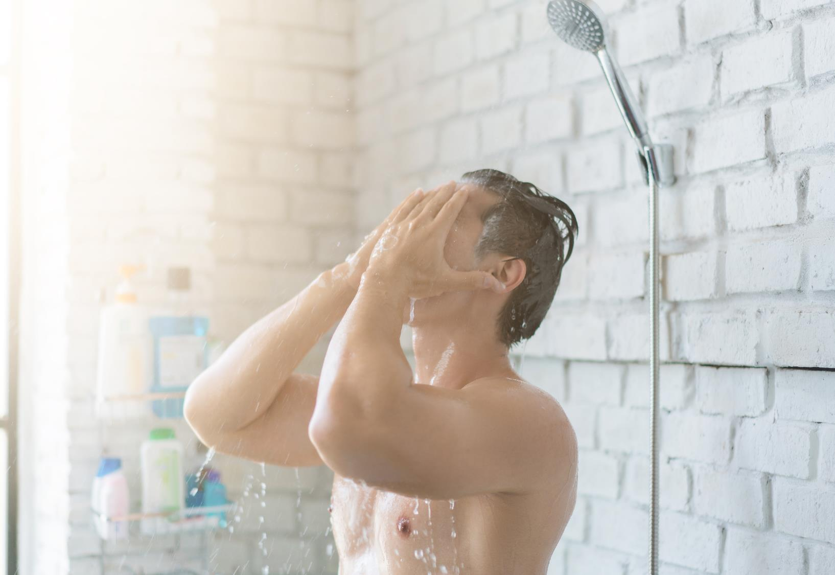


SCALP
REVIVAL
SCRUB
REVITALISING SCRUB CLEANSES TO BALANCE THE SCALP
SALT GRANULES EXFOLIATE TO REMOVE PRODUCT BUILDUP AND DEAD SKIN
LEAVES THE SCALP
FEELING SMOOTHER
SG12019

